Slide 1




The weaponization of web archives: Data craft and COVID-19 publics
Amelia Acker Mitch Chaiet
Presented By:
Himarsha R Jayanetti
PhD Student
Department of Computer Science
Old Dominion University, Norfolk, Virginia
@HimarshaJ @WebSciDL
Created as a course requirement for CS895 Web Archiving Forensics (by Dr. Michael Nelson), Fall 2020
Notes:
https://misinforeview.hks.harvard.edu/article/the-weaponization-of-web-archives-data-craft-and-covid-19-publics/

Slide 2
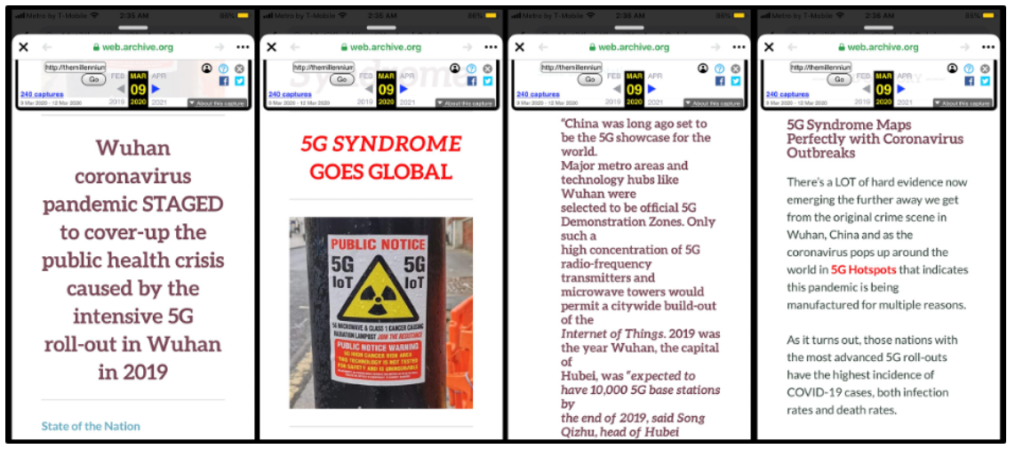
Health Misinformation Content Archived in Internet Archive

Slide 3
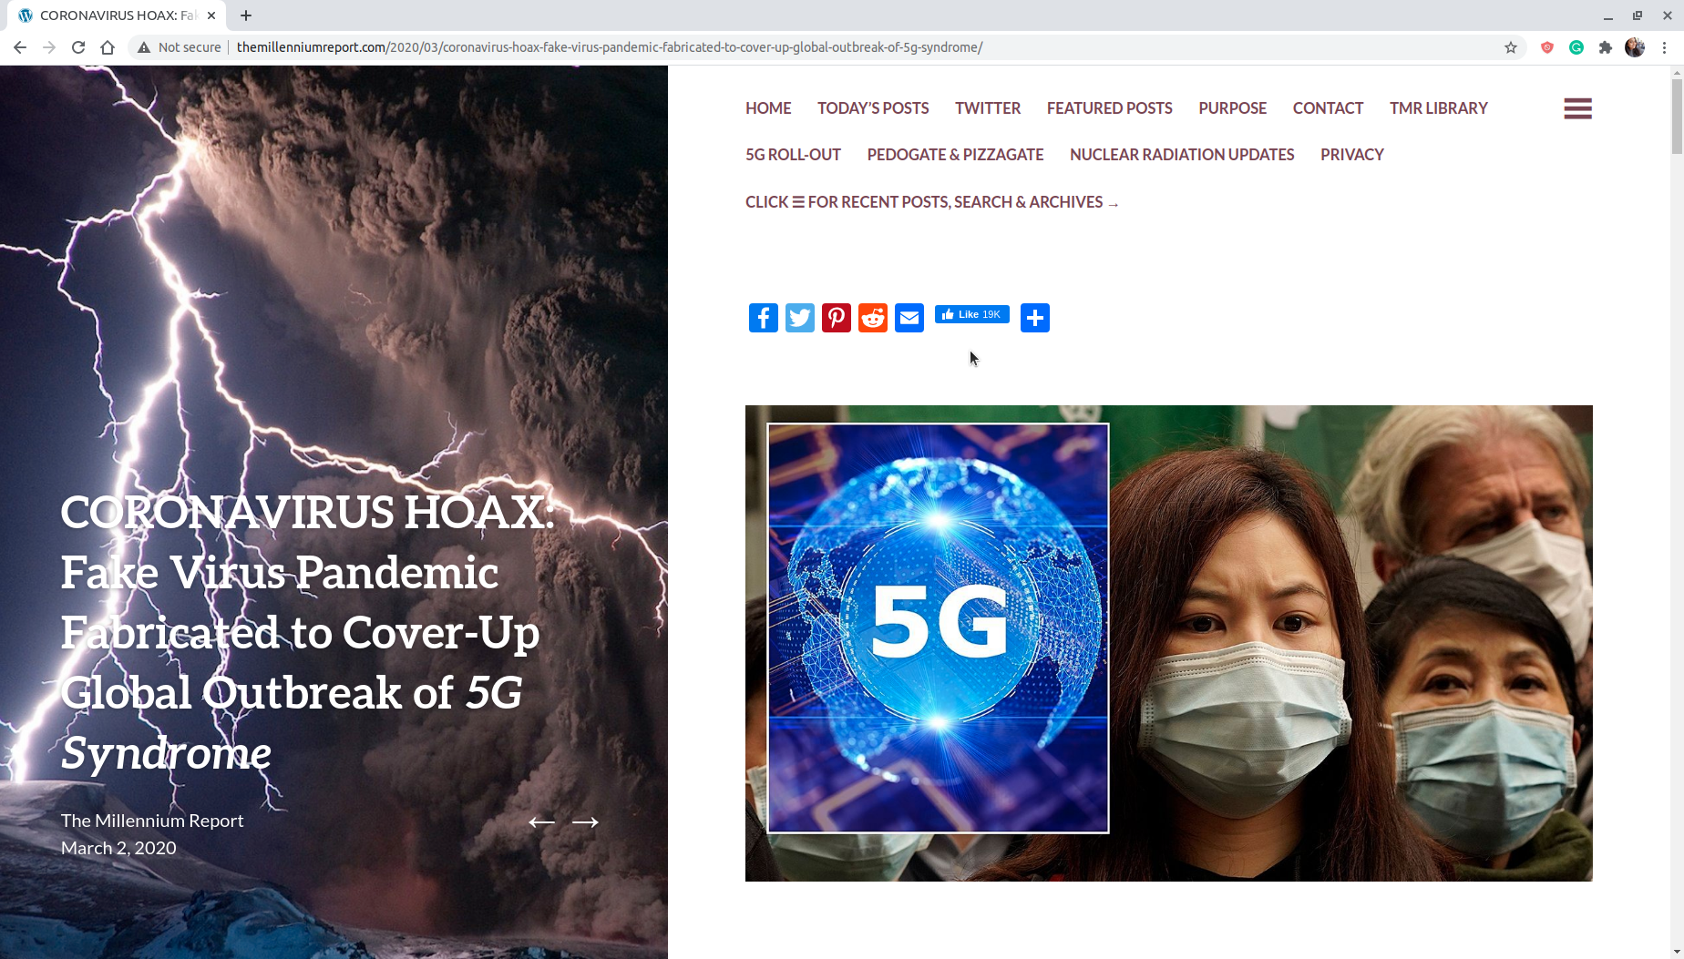
“CORONAVIRUS HOAX: Fake Virus Pandemic Fabricated to Cover-Up Global Outbreak of 5G Syndrome”
http://themillenniumreport.com/2020/03/coronavirus-hoax-fake-virus-pandemic-fabricated-to-cover-up-global-outbreak-of-5g-syndrome/

Slide 4
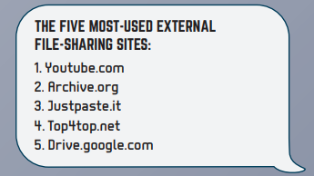
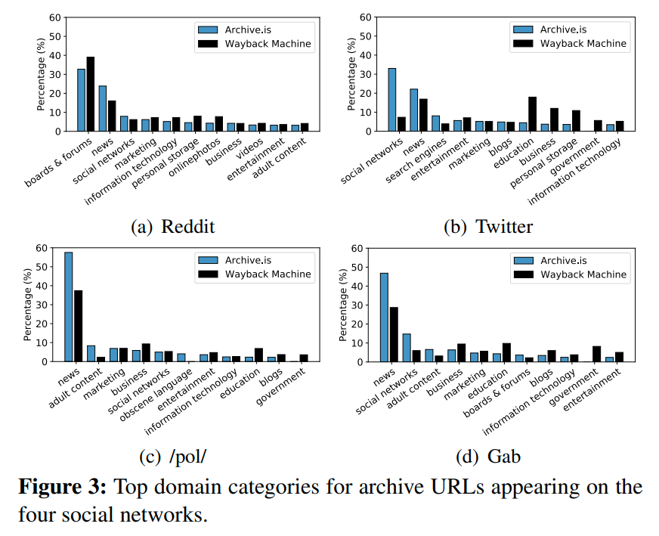
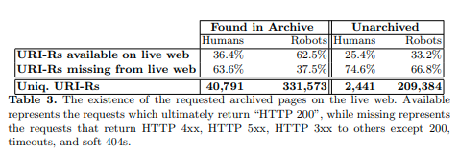
“Web Archives are Used for Link Stability, Censorship Avoidance, and Traffic Siphoning”
Both Archive.is and Wayback machine are often used to spread URLs from news sources, social networks, and marketing sites.
Islamic State Extremists Are Using the Internet Archive to Deliver Propaganda
https://extremism.gwu.edu/sites/g/files/zaxdzs2191/f/Telegram%20Tracker%20Summer%202017.pdf
Blog Post
The percentage of the requested archived pages which currently do not exist on the live web is about 65%
https://arxiv.org/abs/1801.10396
https://arxiv.org/abs/1309.4016
Web Archives are Used for Link Stability, Censorship Avoidance, and Traffic Siphoning
By Hussam Hallak https://ws-dl.blogspot.com/2018/04/2018-04-12-web-archives-are-used-for.html
Notes:
https://www.reddit.com/r/Conservative/comments/58wqig/how_the_clinton_foundation_schemed_with_big/

Slide 5
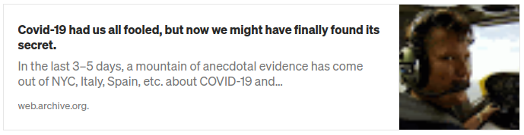
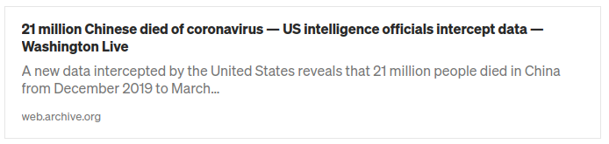
“The Internet Archive Is Being Used As A Disinformation Mule”
http://web.archive.org/web/20200405061401/https://medium.com/@agaiziunas/covid-19-had-us-all-fooled-but-now-we-might-have-finally-found-its-secret-91182386efcb
https://web.archive.org/web/20200406190917/https://n5ti.com/health/1233/
The Internet Archive Is Being Used As A Disinformation Mule, Joe Gray
https://medium.com/@_C_3PJoe/the-internet-archive-is-being-used-as-a-disinformation-mule-fc90a6d07ced
Notes:
https://www.reddit.com/r/Coronavirus/comments/g08rqu/21_million_chinese_died_of_coronavirus_us/

Slide 6
Datacraft
“Practices that create, rely on, or even play with the proliferation of data on social media by engaging with new computational and algorithmic mechanisms of organization and classification”
Acker, A. (2018). Data Craft: The manipulation of social media metadata. Data & Society. https://datasociety.net/output/data-craft/
Notes:
https://github.com/phonedude/cs895-f20/blob/master/assignments/reid/week-09-presentation/Presentation_2_Data_Craft_The_Manipulation_of_Social_Media_Metadata.pdf

Slide 7
Research Questions
How is health misinformation being archived, weaponized, and propagated online?
What does provenance information from web archives reveal about the spread and moderation of harmful content in platforms?
What do these web archiving tactics reveal about information practices during pandemic?
How does screensampling extend the propagation of health misinformation beyond trackable metrics?

Slide 8
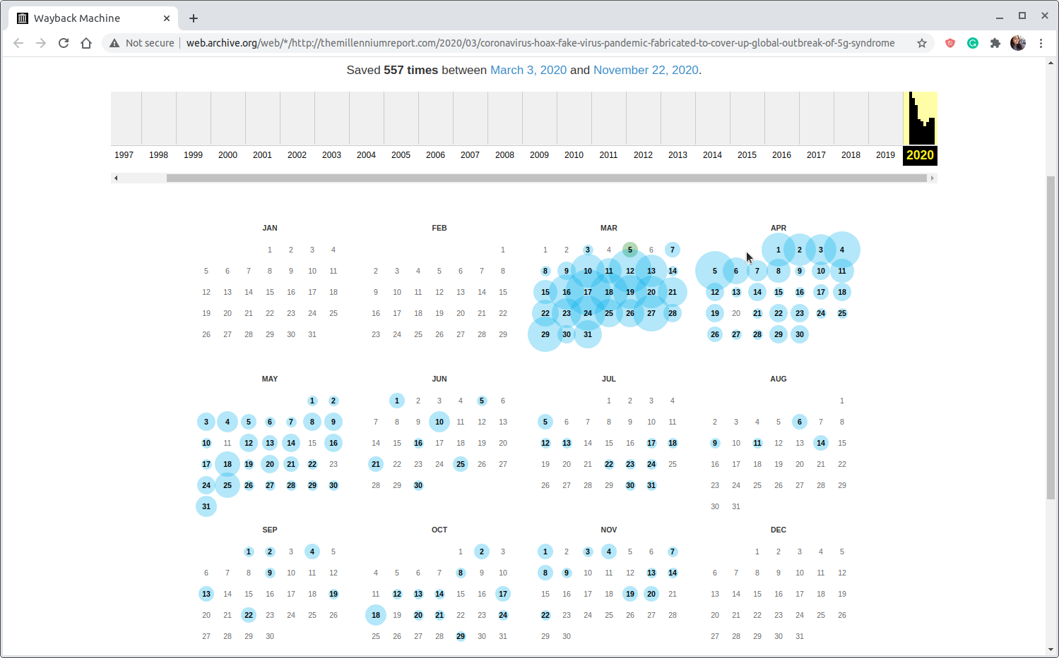
TimeMap of the original article

Slide 9
Web Archiving Techniques: Macro and Micro
Macro Efforts
Carried out on a large scale, by large information institutions.
Relying on web crawling.
Generating “seed lists”
Automated routine
Repeated crawls to build robust, comprehensive snapshots of the quickly changing web.
Micro Efforts
Carried out on a small scale, by individuals or small groups around an event, social movement, or emerging behavior.
More targeted and less routine.
Not limited to search engine indexed websites. Include individual web pages saved through “Save Page Now”.
Finding: Both macro tools and micro tools are overlapping to shape COVID-19 publics and spread misinformation across social platforms, which are increasingly used as public information infrastructures.
Brügger, N. (2018). Web history and social media. Sage Handbook of Social Media, 196–212.

Slide 10
Research Questions
How is health misinformation being archived, weaponized, and propagated online?
What does provenance information from web archives reveal about the spread and moderation of harmful content in platforms?
What do these web archiving tactics reveal about information practices during pandemic?
How does screensampling extend the propagation of health misinformation beyond trackable metrics?

Slide 11
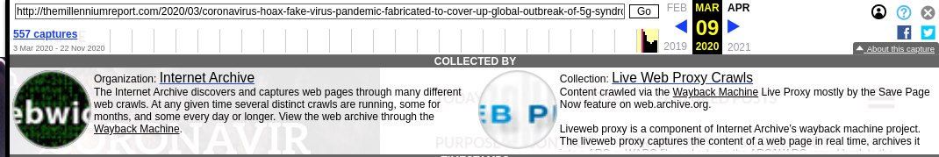
Provenance Information From the Internet Archive’s Multiple Web Crawlers
N=17 different kinds of web crawls .
Collections of outlink URLs posted to Twitter
Collections of Fake News
Archive-It partner collections that subscribe to Internet Archive’s web services.
wide crawls of the whole web, etc.
Finding: The individual human actors had archived and crawled the web page, which then seeded bots for automated routine crawls of the website.

Slide 12
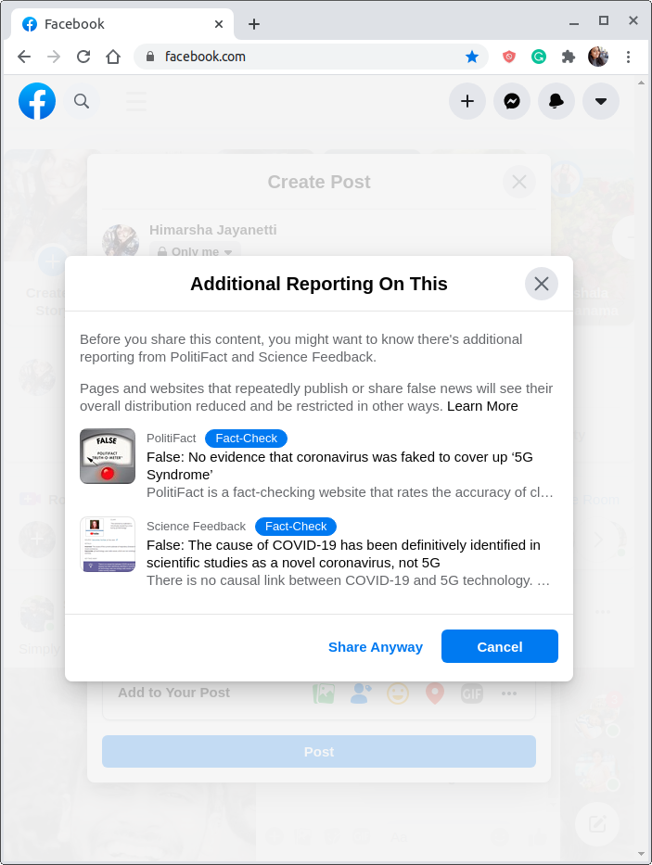
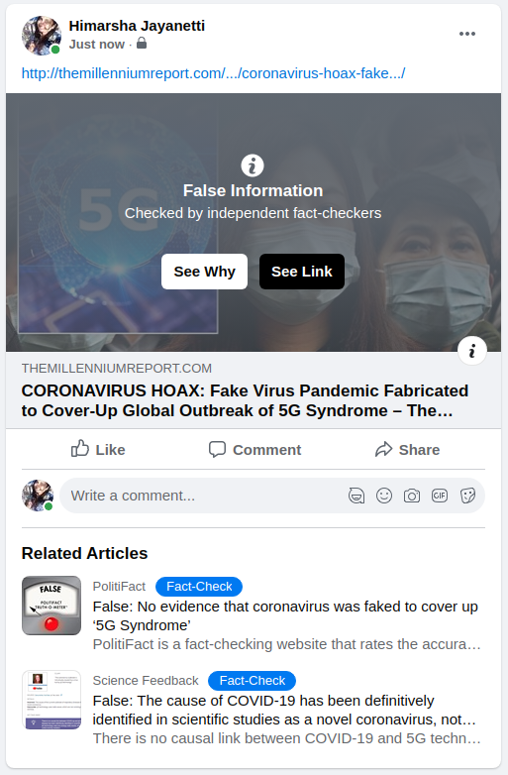
On March 9, 2020, Facebook Began Issuing Warnings to Users Intending to Share the Original URL
Warning label prior to sharing the link
Fact-checked
Notes:
http://themillenniumreport.com/2020/03/coronavirus-hoax-fake-virus-pandemic-fabricated-to-cover-up-global-outbreak-of-5g-syndrome/

Slide 13
Individual Human Agents Began to Proactively Archive It With Save Page Now Only After Facebook Fact-Checked and Labeled the Original Article
March 2: Original article published.
March 3-8: Crawled by automated collections crawlers.
March 9: PolitiFact fact-checked the article.
After March 9: More human agents archiving the article as compared to before.
Finding: Both human and bots were archiving online misinformation, but more individuals used Save Page Now to archive a resource after Facebook moderated and flagged the live URL as health misinformation.

Slide 14
Research Questions
How is health misinformation being archived, weaponized, and propagated online?
What does provenance information from web archives reveal about the spread and moderation of harmful content in platforms?
What do these web archiving tactics reveal about information practices during pandemic?
How does screensampling extend the propagation of health misinformation beyond trackable metrics?

Slide 15
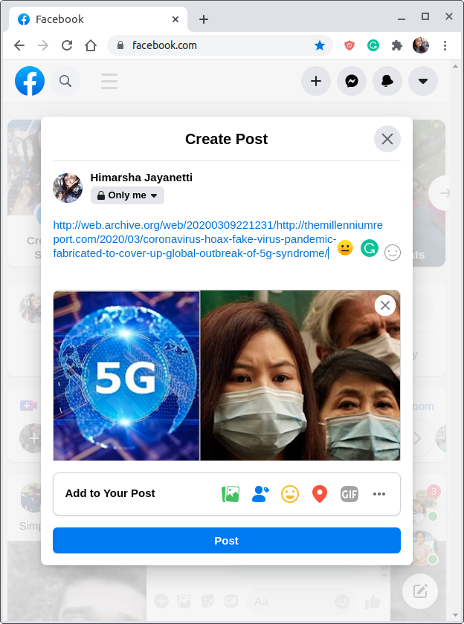
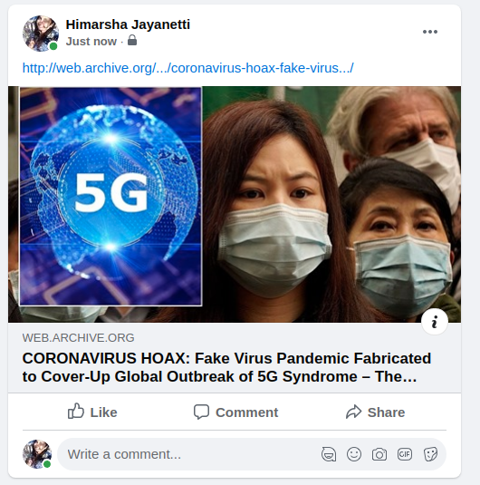
Using IA as a Proxy to Spread Misleading Content
No warning label
Not fact-checked

Slide 16
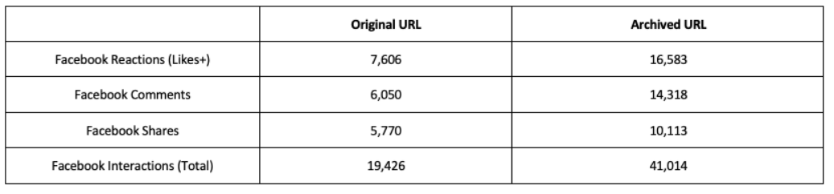
The Archived URL Circulated on Facebook Outperformed the Original Url in Reach, Engagement, Views, and Shares
Original URL: “http://themillenniumreport.com/2020/03/coronavirus-hoax-fake-virus...”
Archived URL: “http://web.archive.org/…./coronavirus-hoax-fake-virus...”
Total interactions with the archived URL is twice more than the original URL.
Table 1: Engagement data from CrowdTangle comparing original URL and archived URL.

Slide 17
Research Questions
How is health misinformation being archived, weaponized, and propagated online?
What does provenance information from web archives reveal about the spread and moderation of harmful content in platforms?
What do these web archiving tactics reveal about information practices during pandemic?
How does screensampling extend the propagation of health misinformation beyond trackable metrics?

Slide 18
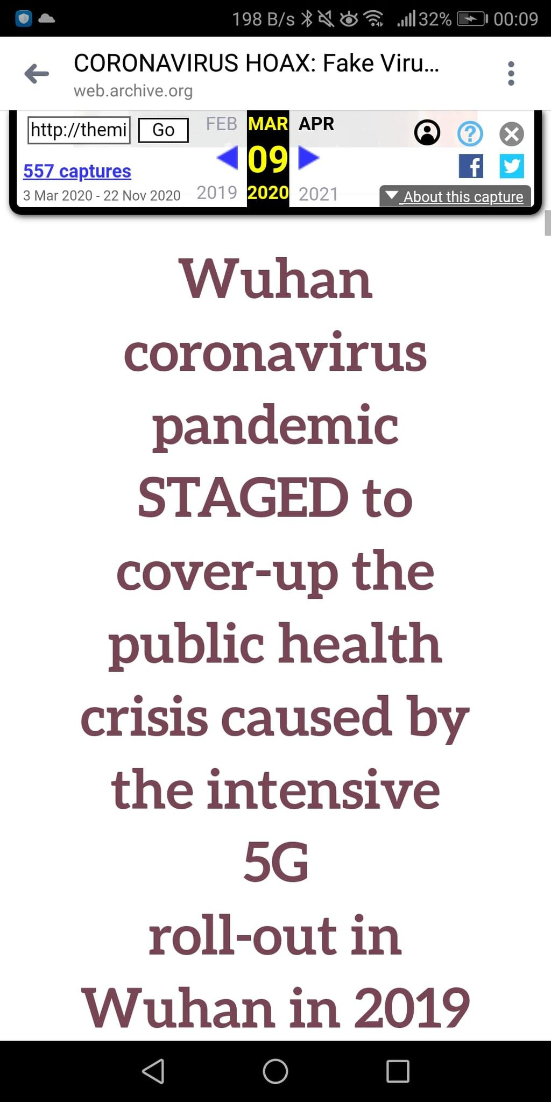
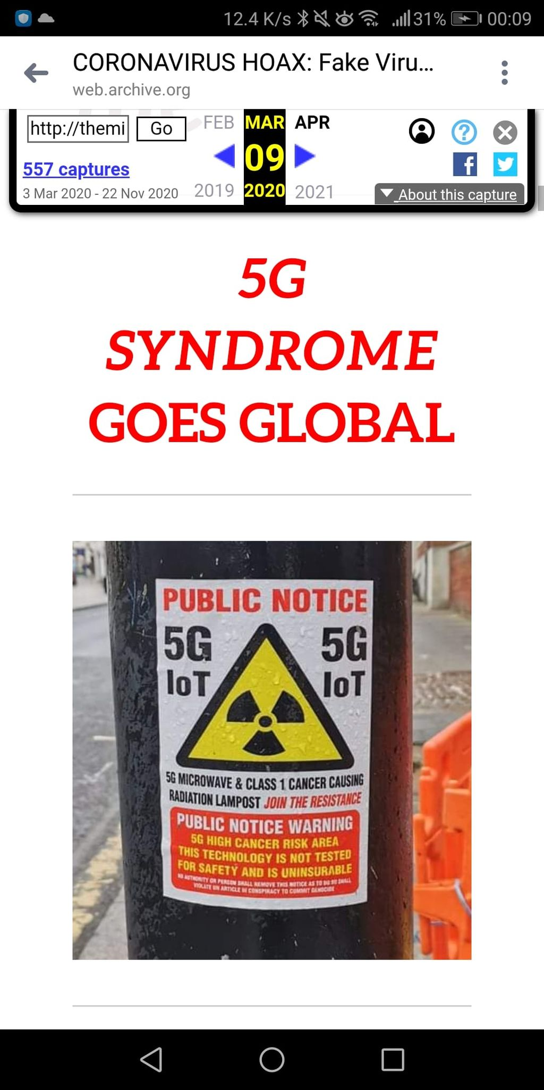
Screensampling
“A data craft technique that extends the propagation of archived misinformation when social media users post screenshots of archived URLs thus removing the ability to click or track these static images of archived online sources”
Acker, A.; Chaiet, M. (2020). The weaponization of web archives: Data craft and COVID-19 publics. The Harvard Kennedy School (HKS) Misinformation Review. https://doi.org/10.37016/mr-2020-41

Slide 19
Screensampling Makes It Worse
Posting images of text allows human readers to view the content while bypassing content moderation mechanisms because image formats with text are not easily machine-readable.
Allows people to recontextualize and propagate content from a trusted source (the Wayback Machine).
Difficult for users, researchers, and platforms trying to determine the original source of the content.
Social analytics tools like CrowdTangle will never be able to quantify the number of users who screenshot an article and then post portions of it with their own framing commentary.

Slide 20
Key Takeaways:
IA’s Wayback Machine and Archive.is are used by people to preserve and spread health misinformation on platforms like Facebook and Twitter.
Archived web resources are used by people to intentionally bypass automated content moderation efforts like fact-check warnings.
Screensampling is even more difficult for detection by automated content moderation systems, and as a result they circulate for longer on platforms.
Social media platforms should be aware of people using web archives as a proxy, and take necessary actions to label and classify misinformation.

